Slide 1

Project Execution and
Continuous Quality Improvement Tools
Presenter: Jennifer LoGalbo
RHP 8 Monthly Learning Collaborative Call
February 10, 2015

Slide 2
Objectives
Review Project Management (PM) Process
Define Execution Phase
Review Continuous Quality Improvement (CQI) Tools
Q&A

Slide 3
Project Management Process
Initiating
Monitoring
Closing
Planning
Executing
Select project manager
Define roles and responsibilities
Determine project team
Estimate costs and time
Complete the work
Report on performance
Measure performance against baseline
Update documents
Perform quality control
Divide large projects
Create objectives
Archive and index project documents
Gather lessons learned
Manage people
Create communication plan

Slide 4
Executing Phase – 22 Steps
Executing
(see complete list of 22 activities on slides 15-16)
Execute work according to the project management plan
Request changes
Continuously improve
Determine whether processes are correct and effective (quality assurance)
Evaluate team and individual performance
Hold team-building activities
Give recognition and awards
Release resources as work is completed
Report on project performance
Manage stakeholder engagement and expectations

Slide 5
Planning Phase - Templates
Executing
(see complete list of 22 activities on slides 15-16)
Execute work according to the project management plan
Request changes
Continuously improve
Determine whether processes are correct and effective (quality assurance)
Evaluate team and individual performance
Hold team-building activities
Give recognition and awards
Release resources as work is completed
Report on project performance
Manage stakeholder engagement and expectations

Slide 6
Why is the execution phase important?
Purpose: Complete project work as defined in the project management plan, and meet project objectives outlined from the onset.
Goal: Achieve completion of project deliverable(s) within the planned budget and schedule.
DSRIP semi-annual reporting requirements – April and October.

Slide 7
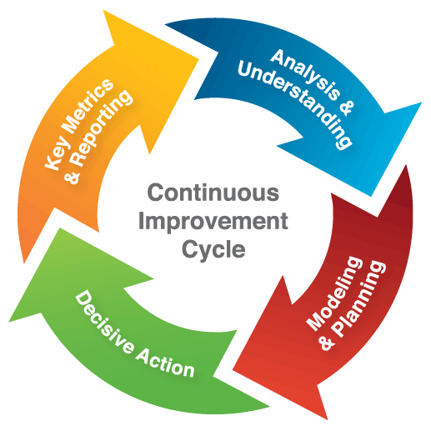
CQI – Definition and Tools
What is CQI?
CQI tools:
  Cause & Effect Diagram
  (a.k.a., Ishikawa or Fishbone)
  5 Why’s
  Business Process Mapping (BPM)
  Plan, Do, Study, Act
Continuous Quality Improvement

Slide 8
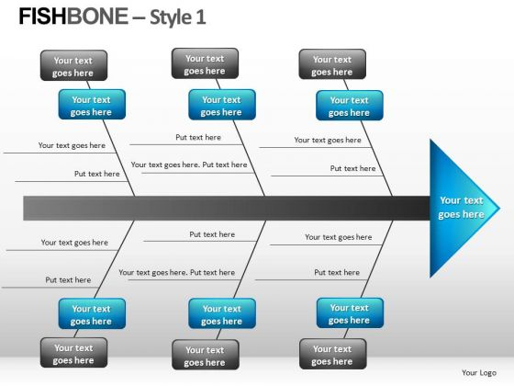
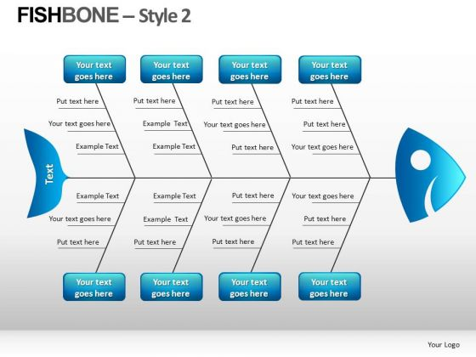
Cause & Effect
Reference: Cause and Effect Analysis: Identifying the Likely Causes of Problems. (n.d.). Retrieved January 14, 2015, from http://www.mindtools.com/pages/article/newTMC_03.htm

Slide 9
Cause & Effect, example

Slide 10
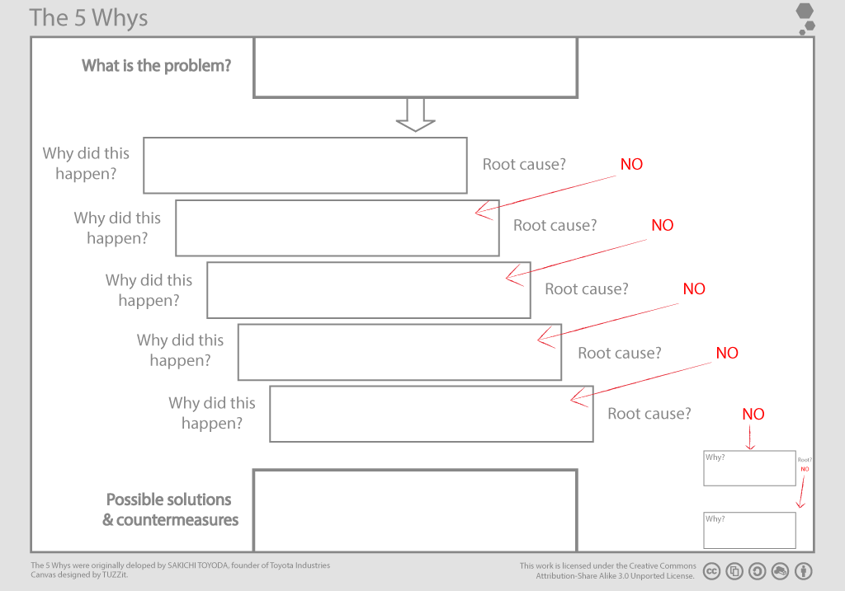
5 Why’s
Reference: (n.d.). Retrieved January 14, 2015, from https://www.tuzzit.com/en/canvas/5_whys_canvas

Slide 11
5 Why’s, example
Problem Statement:
The patient waited longer than 45 minutes
before they were seen by a nurse.
Why?
Why did the patient have to wait longer than 45 minutes before they were seen by a nurse?
Why?
The nurse was unable to pull the information using the current EHR system.
Why?
Clinic staff have not received usernames and login information from the IT department.
Why?
Why?
The nurse was at the hospital.
The nurse needed to pull the patient’s file before the appointment.
The nurse was not in the clinic.
Why wasn’t the nurse in the clinic?
Why was the nurse at the hospital?
Why wasn’t the nurse able to pull the patient’s file at the clinic?
Why wasn’t the nurse able to pull date using the current EHR system?

Slide 12
BPM Tools
Charts, graphs and diagrams visually display what the process is and who is involved
Various tools are available, some of these include:
  Process Charting
  Top-Down Flow Chart
  Block Diagram
  Activity Chart
  Work-Flow Diagram
  Cross-Functional Flow Chart
Note: See RHP 8 Anchor team presentation from November 14, 2014 for additional information on the tools above

Slide 13
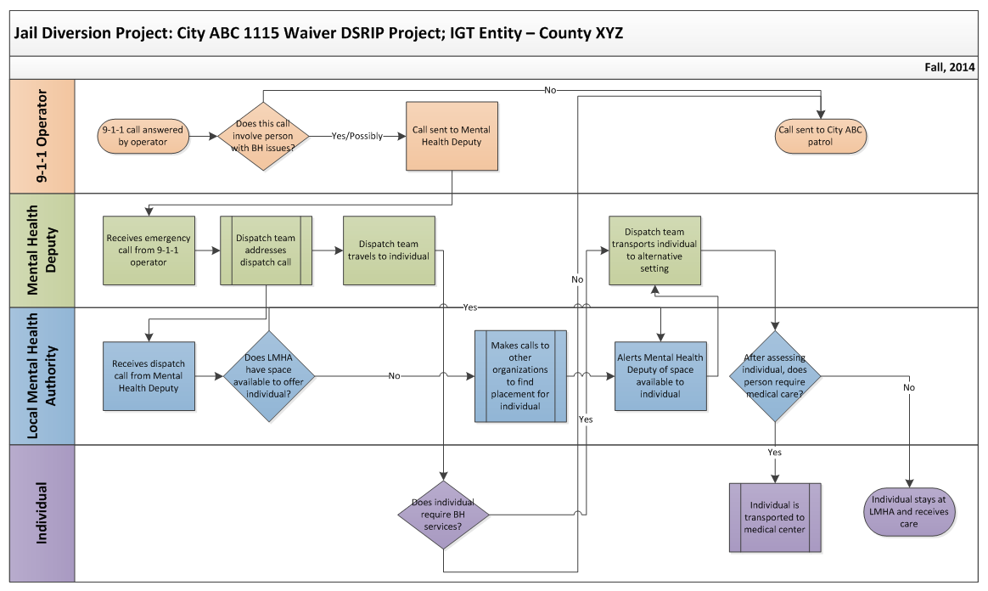
BPM Tools, example

Slide 14
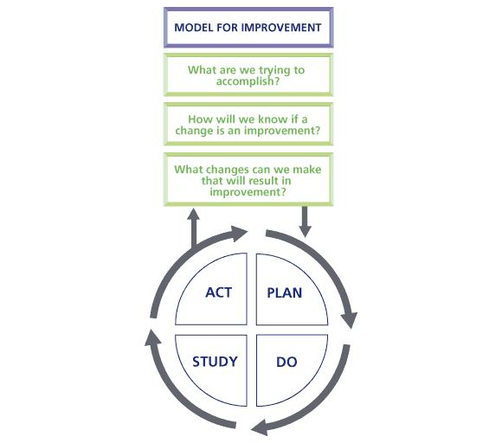
Plan, Do, Study, Act
Reference: Plan, Do, Study, Act (PDSA). (n.d.). Retrieved January 14, 2015, from http://www.institute.nhs.uk/quality_and_service_improvement_tools/quality_and_service_improvement_tools/plan_do_study_act.html

Slide 15
Executing Stage – Activities
Execute work according to the project management plan
Produce product deliverables (product scope)
Gather work performance data
Request changes
Implement only approved changes
Continuously improve
Follow processes
Determine whether processes are correct and effective (quality assurance)
Perform quality audits
Acquire final team
Manage people

Slide 16
Executing Stage – Activities, Con’t.
Evaluate team and individual performance
Hold team-building activities
Give recognition and awards
Use issue logs
Facilitate conflict resolution
Release resources as work is completed
Send and receive information, and solicit feedback
Report on project performance
Manage stakeholder engagement and expectations
Hold meetings
Select sellers

Slide 17
Resources and Contact Information
Mulcahy, R. (2013). PMP exam prep: Accelerated learning to pass PMI's PMP exam (8th ed.). Minnetonka, Minn.: RMC publications.
Contact Information:
  Jennifer LoGalbo
  RHP 8 Program Director
  512-341-4962
  logalbo@tamhsc.edu

Slide 18
Q&A

