Slide 1

Project Monitoring and
Stakeholder Engagement
Presenter: Jennifer LoGalbo
RHP 8 Monthly Learning Collaborative Call
March 10, 2015

Slide 2
Objectives
Review Project Management (PM) Process
Define Monitoring Phase
Discuss Importance of Stakeholder Engagement
Review Project Status Update Template
Q&A

Slide 3
Project Management Process
Initiating
Monitoring
Closing
Planning
Executing
Select project manager
Define roles and responsibilities
Determine project team
Estimate costs and time
Complete the work
Report on performance
Measure performance against baseline
Update documents
Perform quality control
Divide large projects
Create objectives
Archive and index project documents
Gather lessons learned
Manage people
Create communication plan

Slide 4
Monitoring Phase – 19 Activities
Executing
(see complete list of 19 activities on slides 11-12)
Measure performance against performance measurement baseline
Analyze and evaluate performance
Request changes
Perform integrated change control
Update and PM plan and project documents
Inform stakeholders of the results of change requests
Monitor stakeholder engagement

Slide 5
Monitoring Phase - Templates
Executing
(see complete list of 19 activities on slides 11-12)
Measure performance against performance measurement baseline
Analyze and evaluate performance
Request changes
Perform integrated change control
Update and PM plan and project documents
Inform stakeholders of the results of change requests
Monitor stakeholder engagement

Slide 6
Why is the monitoring phase important?
Purpose: This phase oversees all tasks to ensure the project metrics are being met within scope, on-time and on-budget.
Goal: Ensure project proceeds smoothly with minimal risks.
DSRIP Providers: During the remaining life of the Waiver project, it is important to communicate project successes, challenges, lessons learned, and reporting updates with stakeholders (both internal and external).

Slide 7
What is stakeholder engagement?
The people who should be included as part of the project who either affect the project, or who are affected by the project.
Identified at onset of the project.
  Refer to January RHP 8 monthly call materials – Project Communication Plan
Continually kept informed of project status during life of project.
  Internal vs. External
  Bi-monthly, Monthly, or Weekly Updates
  In-Person, Email, or Phone

Slide 8
How do you manage stakeholder involvement ?
Identify who to include
Determine requirements, expectations, interest, and level of influence
Plan how you will communicate with them
Manage their expectations, influence, and engagement

Slide 9
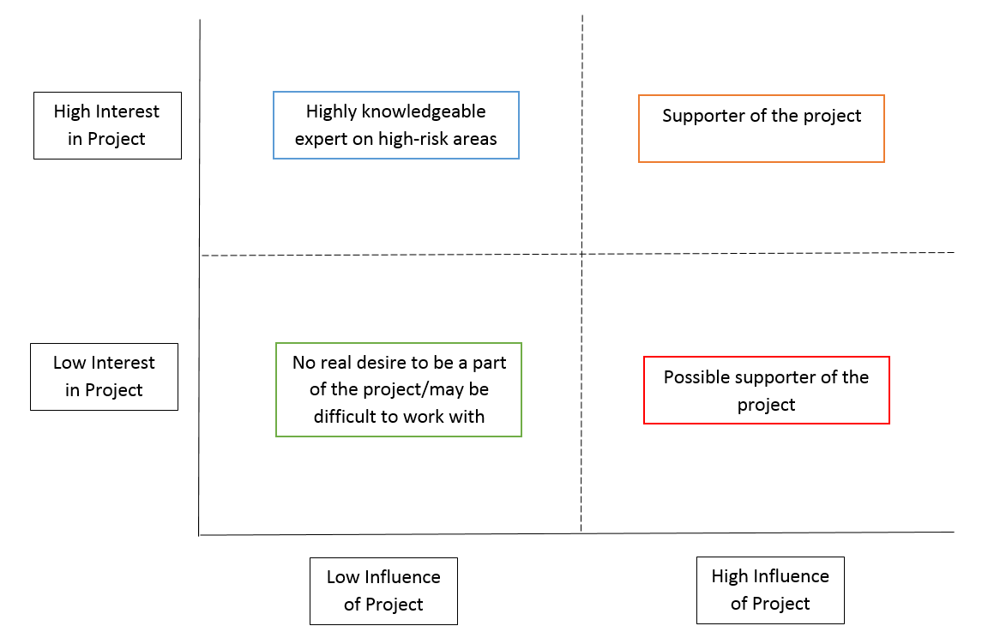
How do you determine stakeholder involvement?

Slide 10
Template Review

Slide 11
Monitoring Stage – Activities
Take action to control project
Measure performance against performance measurement baseline
Measure performance against other metrics in the PM plan
Analyze and evaluate performance
Determine if variances warrant a corrective action or other change request
Influence the factors that cause change
Request changes
Perform integrated change control
Approve or reject changes
Update and PM plan and project documents

Slide 12
Executing Stage – Activities, Con’t.
Inform stakeholders of the results of change requests
Monitor stakeholder engagement
Manage configuration
Create forecasts
Gain acceptance of interim deliverables from the customer
Perform quality control
Perform risk assessments and audits
Manage reserves
Control procurements

Slide 13
Resources and Contact Information
Mulcahy, R. (2013). PMP exam prep: Accelerated learning to pass PMI's PMP exam (8th ed.). Minnetonka, Minn.: RMC publications.
Contact Information:
  Jennifer LoGalbo
  RHP 8 Program Director
  512-341-4962
  logalbo@tamhsc.edu

Slide 14
Q&A

