Slide 1

Business Process Mapping as a
Continuous Quality Improvement Tool
Presenter: Jennifer LoGalbo
RHP 8 Monthly Learning Collaborative Call
November 14, 2014

Slide 2
Objectives
Welcome and Introductions
Review Traditional Management vs. Systems Thinking
Define Business Process Mapping (BPM)
Review Brief History and Overview of BPM
Discuss Various BPM Tools
Share Resources/Examples
Q&A

Slide 3
What is Systems Thinking?
Traditional Management
Systems Thinking
vs.
Inputs
Process
Outputs
Gaps
Inputs
Process
Outputs
Gaps
Commonly, the process goes unchecked – organizations aren’t concerned with the process until outputs become unacceptable (e.g., costs, quality, speed, services, etc.).
Implementing BPM allows the organization to manage the process vs. allowing the process to manage the business.

Slide 4
BPM – Definition
BPM refers to activities involved with identifying:
  Who is responsible for various tasks?
  What is it the organization does?
  Where is a business process being addressed?
  When is there a process inefficiency?
  Why is a business process done a certain way?
BPM Goal:
  Create stable, strong, and consistent outputs.
Inputs
Process
Outputs
Gaps

Slide 5
BPM - History
2000s - Process Based Competition
SWOT Analysis; organization assessment
Late 1990s - Process Oriented
Organization chart analysis; performance management
Early 1990s - Process Reengineering
One-time technology-driven change; project management
1980s - Total Quality Management
Continuous work process improvement; team facilitation

Slide 6
BPM - Overview
Key tool for process management initiatives
  Importance of understanding the overall process before looking at the details of the process
  Identify gap to be addressed, and then chose the tool that best aligns with that goal
Three areas drive tool selection:
  Audience
  Intent
  Gap

Slide 7
BPM - Tools
Charts, graphs and diagrams visually display what the process is and who is involved
Various tools are available, some of these include:
  Process Charting
  Top-Down Flow Chart
  Block Diagram
  Activity Chart
  Work-Flow Diagram
  Cross-Functional Flow Chart

Slide 8
Process Charting
When to use it?
  When trying to gain a general, overview of activities in an organization
Shortcomings:
  Provides very broad overview and does not show details; may become confusing when multiple people are involved/multiple processes
Example:
  Provider may use this approach when mapping out various DSRIP Projects underway in an organization

Slide 9
Process Charting, Example
Texas LMHA
Jail Diversion for Persons with BH Needs
Veteran Peer Support
Transitional Housing
Telemedicine
Trauma Informed Care

Slide 10
Top-Down Flow Chart
When to use it?
  Primarily used to provide a macro view of primary steps, and then a micro account of the process sub-steps if needed (not to be confused with work breakdown schedule)
Shortcomings:
  Does not demonstrate cross-functional relationships; process time or costs; decision trees; frequently repeated steps and non-value added steps
Example:
  Provider may use this approach to understand the flow of a patient checking-in, visiting with doctor/nurse, completing patient satisfaction survey, and checking-out

Slide 11
Top-Down Flow Chart, Example
Patient/Front Desk Staff Interaction
Patient Enters Clink
Patient/Nurse and Doctor Interaction
Patient/Nurse and Front Desk Staff Interaction
Nurse Reviews Patient Information
Patient Signs In
Patient Provides Insurance Information to Front Office Staff
Front Office Staff Fills Out Paperwork
Front Office Staff Alerts Nurse Patient is Present
Nurse Calls Patient
Nurse Performs Check In Tasks (blood pressure, heart rate, weight)
Nurse Takes Patient to Waiting Room
Doctor Visits with Patient about Concerns
Doctor makes Referrals as Needed
Doctor Exits
Nurse Enters and offers Patient Satisfaction Survey (PSS)
Patient Completes Survey
Patient Waits while Nurse Follows-Up on Referral(s)
Nurse Scores PSS by Hand
Nurse Enters PSS in Database
Nurse Releases Patient with Next Appointment Information
Front Office Staff Scans in Documents
Doctor Reviews Patient Information

Slide 12
Block Diagram
When to use it?
  These are flexible diagrams that allow users to outline details at both the macro and micro levels, decision trees, responsibility charts, and/or process vs. cycle time charts
Shortcomings:
  These diagrams present difficulty in trying to depict various cross-functional activities; diagrams may appear busy
Example:
  Providers may use this approach when navigating a patient to another healthcare provider

Slide 13
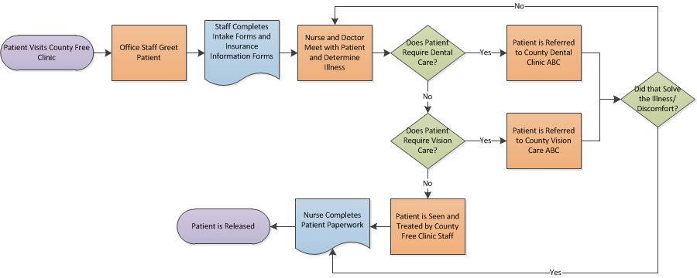
Block Diagram, Example
Legend:
Beginning/End of Process – Purple
Operation – Orange
Decision – Green
Documentation – Blue

Slide 14
Activity Chart
When to use it?
  These tools allow organizations to map out how long activities take, and where processes may be streamlined to enhance productivity
Shortcomings:
  These visuals do not capture cross-functional tasks, nor do they show parallel process; elapse in time may not show true “time”
Example:
  Providers may use this approach when attempting to improve process times and getting more individuals helped/assisted at a community health fare

Slide 15
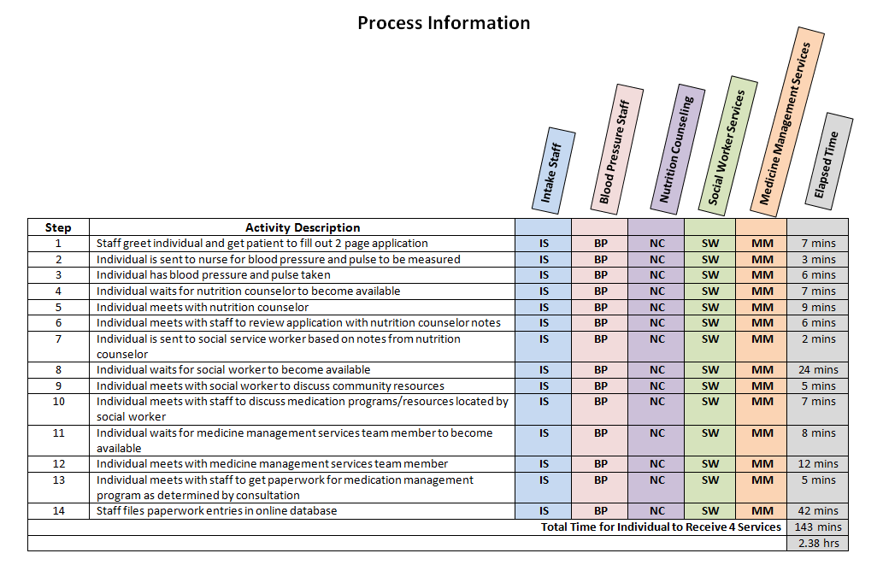
Activity Chart, Example - Outline

Slide 16
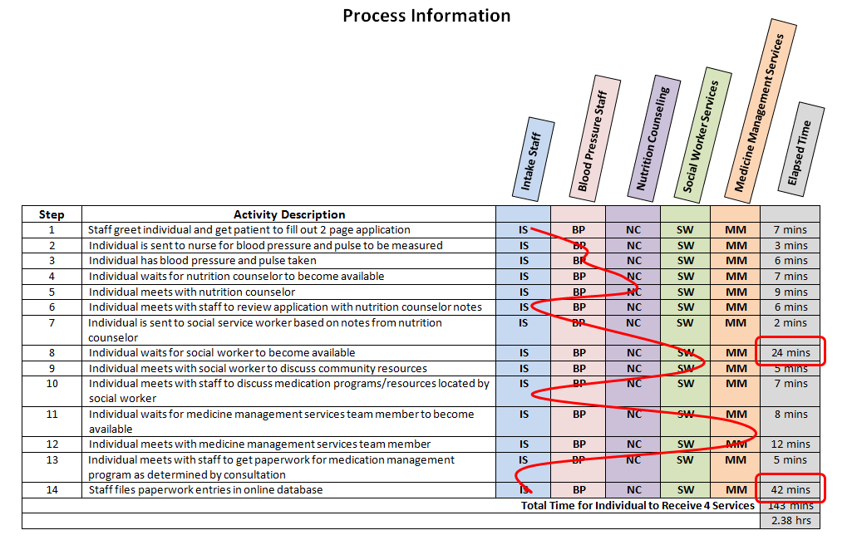
Activity Chart, Example - Flow

Slide 17
Work-Flow Diagram
When to use it?
  This visual offers users the opportunity to map the physical location of people and/or activities with a system to determine optimal positioning
Shortcomings:
  This tool does not necessarily describe the activity taking place, but it simply shows the location
Example:
  Providers may use this approach when mapping out how to streamline the physical layout of an office space to better assist patients and nurses in an effort to reduce wait/down time

Slide 18
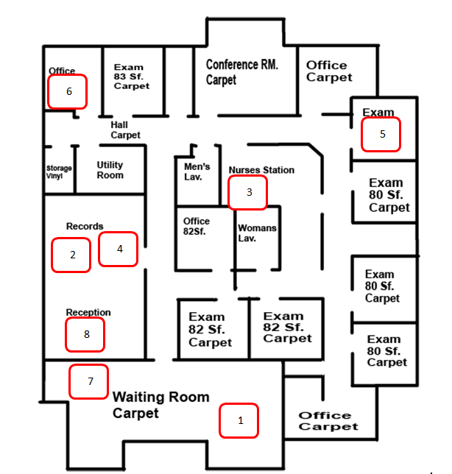
Work-Flow Diagram, Example - Outline
Patient enters clinic
Nurse pulls patient record from storage room
Patient is taken to nurse station
Nurse files vitals in patient records
Patient is taken to exam room
Nurse consults with doctor prior to appointment
Nurse takes patient to waiting room
Nurse files paperwork in record storage room

Slide 19
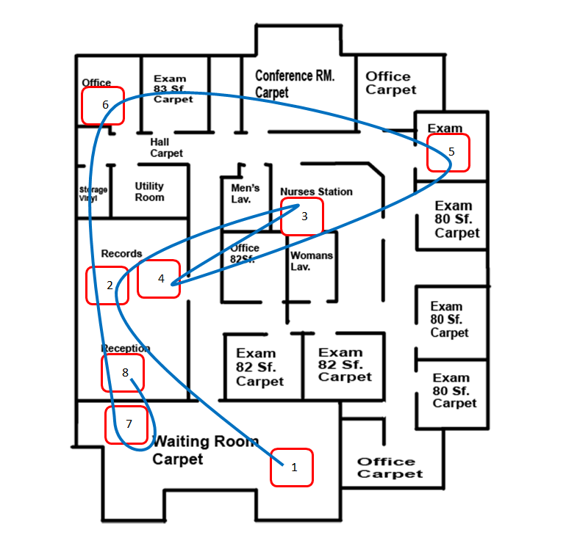
Work-Flow Diagram, Example - Flow

Slide 20
Cross-Functional Flow Chart
When to use it?
  Typically this is the flow chart used by most organizations when depicting macro level of activities along with associated responsible persons/departments (allows users to see “handoffs”)
Shortcomings:
  Chart may look “too busy” if multiple micro activities are added; and listing names/departments may cause confusion
Example:
  Providers may use this approach when attempting to show upper-management the overview of a county’s jail diversion project for persons with behavioral health needs

Slide 21
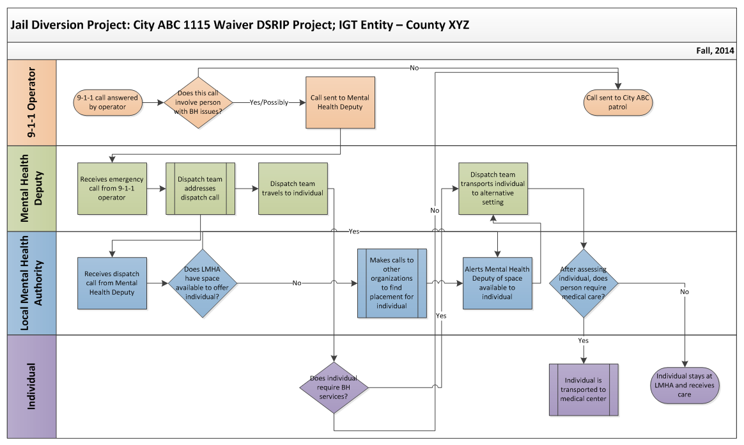
Cross-Functional Flow Chart, Example

Slide 22
Resources and Contact Information
Process Mapping: How to Streamline and Reengineer Business Processes. .90216th ed. Vol. 9.05. Orion Developer Group, 2009. Print.
Microsoft Office Suite: Visio, Word, and PowerPoint
Contact Information:
  Jennifer LoGalbo
  RHP 8 Program Director
  512-341-4962
  logalbo@tamhsc.edu

Slide 23
Q&A

