Slide 1

RHP 8 & 17 Joint Learning Collaborative Event
Lunch and Learn Presentation: Appreciative Inquiry
Presenter: Gina Lawson, RHP 8 Program Assistant
Tuesday, September 23, 2014
12:00 – 1:00 p.m.

Slide 2
Overview
Introductions
Presentation Outline
  Learning Objectives:
    Describe Key Concepts of Appreciative Inquiry (AI)
    Identify AI resources
  Quality Improvement and Assurance Overview
  Appreciative Inquiry Overview
  Resources/Examples
  Q&A

Slide 3
Do you want to help your DSRIP team(s)…
Create an engaging and exciting collective vision?
Enhance the sense of community and creativity?
Build upon leadership skills and train future leaders?
Open the lines of communication and collaboration between staff, patients and stakeholders?
Work toward sustainability?
Appreciative Inquiry (AI) applications and resources can help you and your organization accomplish these goals and much more.

Slide 4

Relationship between
AI, QA & QI
Quality Assurance (QA) finds problems in performance.
Quality Improvement (QI) fixes problems in performance.
Courtesy of Hunter Gatewood, Improvement Advisor, Signal Key Consulting
Signal Key Consulting

Slide 5
What is Appreciative Inquiry?
AI is an approach for engaging staff at all levels to produce effective, positive change as a continuous quality improvement (CQI) tool.
AI begins by identifying what is positive and connecting it in ways that heighten energy, vision, and action for change.
Cooperrider, David L., Diana Whitney, and Jacqueline M. Stavros. Appreciative Inquiry Handbook - For Leaders of Change. 2nd ed. Brunswick: Crown Custom, 2008. Print.

Slide 6
What is a Positive Core?
Positive Core

Slide 7
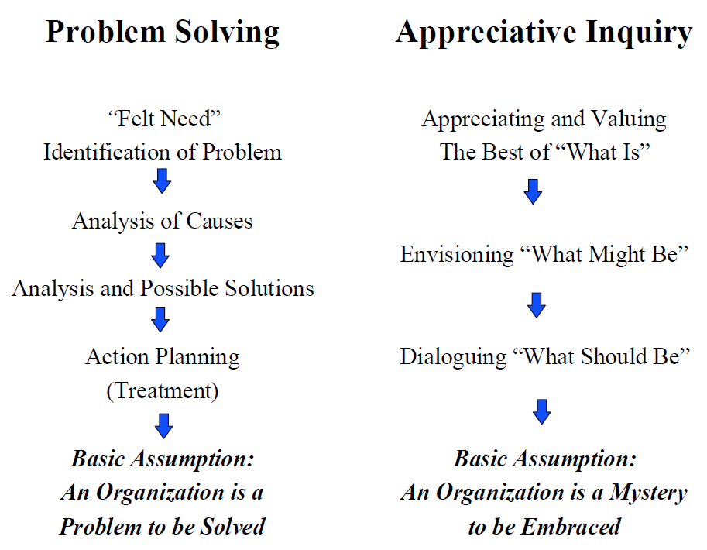
Traditional Problem Solving vs. AI
Figure 1.2 - Cooperrider, David L., Diana Whitney, and Jacqueline M. Stavros. Appreciative Inquiry Handbook - For Leaders of Change. 2nd ed. Brunswick: Crown Custom, 2008. Print.
Discovery
Dream
Design
Destiny

Slide 8
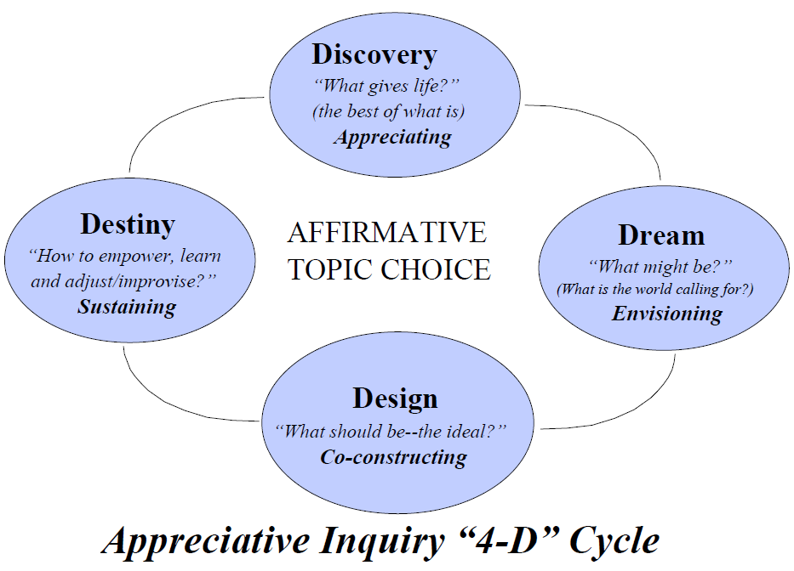
Overview of AI 4-D Cycle
Figure 1.1 - Cooperrider, David L., Diana Whitney, and Jacqueline M. Stavros. Appreciative Inquiry Handbook - For Leaders of Change. 2nd ed. Brunswick: Crown Custom, 2008. Print.

Slide 9

Affirmative Topic Choices
Stated in the positive
Objectives staff want to accomplish and learn more about

Slide 10


AI helps teams operate at their best by focusing on its positive core and using positive dialogue.
Which team would you like to be on?
A or B

Slide 11
AI Foundational Questions – Interviewing Process
1. What would you describe as being a peak experience or high point in your life-personal or professional?
2. What do you value most about yourself? Your work? Your organization?
3. What is the core factor that gives life to your organization?
4. Describe your vision of the future for the organization and your world.
Cooperrider, David L., Diana Whitney, and Jacqueline M. Stavros. Appreciative Inquiry Handbook - For Leaders of Change. 2nd ed. Brunswick: Crown Custom, 2008. Print.

Slide 12
Managing Change
Cooperrider, David L., Diana Whitney, and Jacqueline M. Stavros. Appreciative Inquiry Handbook - For Leaders of Change. 2nd ed. Brunswick: Crown Custom, 2008. Print.
A Healthy Organization
NOVELTY
Managing: Curiosity, Dreams & Changing the Process
TRANSITION
Managing: Next Steps, Feedback, Celebrating Progress
CONTINUITY
Managing: Core Values, Strengths, Minimal Disruption

Slide 13
Example: Getting Started Worksheet
1. Our organization will use AI because we want to ______________ in
order to ______________.
2. Who will lead this AI initiative?
3. What is the time frame for the effort?
4. How many people and who will be involve?
5. How will we select the affirmative topics for the inquiry?
6. How many interviews will we conduct and who will conduct them?
Other questions included on worksheet.
Cooperrider, David L., Diana Whitney, and Jacqueline M. Stavros. Appreciative Inquiry Handbook - For Leaders of Change. 2nd ed. Brunswick: Crown Custom, 2008. Print.

Slide 14
Where Can I Apply AI?
Table 7.1 - Cooperrider, David L., Diana Whitney, and Jacqueline M. Stavros. Appreciative Inquiry Handbook - For Leaders of Change. 2nd ed. Brunswick: Crown Custom, 2008. Print.
Staff/Management Training & Development
Customer Satisfaction
Strategic Planning
Team Development
Work Process Redesign

Slide 15
Example 1: Starting a New Partnership
1. Reflecting on your experience, describe a time when you partnered with one or more people to complete a project. What are some principles or values that made the experience a positive and productive one? What contributions made you most proud of and satisfied with the partnership.
Adapted by Cardea Services with permission from Miller, Carolyn J., and Cristina R. Aguilar. The Nonprofits Guide to the Power of Appreciative Inquiry. Denver: Community Development Institute, 2004. Print.

Slide 16
Example 2: Starting a New Partnership
2. Describe a time when your organization partnered with another agency to enhance services for the community you serve.
What was the purpose of the project? Who were the other agencies involved? Who benefitted from the partnership?
What made the partnership and project successful?
What strategies did the partners use to create unity, shared understanding and common purpose?
Adapted by Cardea Services with permission from Miller, Carolyn J., and Cristina R. Aguilar. The Nonprofits Guide to the Power of Appreciative Inquiry. Denver: Community Development Institute, 2004. Print.

Slide 17
Example 3: Starting a New Partnership
3. Dream into the future…Three years from now your organizations have successfully partnered to enhance your services. What are the issues that have improved as a result of the partnership? In a speech talking about this collaboration, identify three underlying principles that enabled each partner to feel it shared in a “win-win” partnership.
Adapted by Cardea Services with permission from Miller, Carolyn J., and Cristina R. Aguilar. The Nonprofits Guide to the Power of Appreciative Inquiry. Denver: Community Development Institute, 2004. Print.

Slide 18





Who uses AI?
United Nations
Cooperrider, David L., Diana Whitney, and Jacqueline M. Stavros. Appreciative Inquiry Handbook - For Leaders of Change. 2nd ed. Brunswick: Crown Custom, 2008. Print.

Slide 19
References, Resources and Links
Cooperrider, David L., Diana Whitney, and Jacqueline M. Stavros. Appreciative Inquiry Handbook - For Leaders of Change. 2nd ed. Brunswick: Crown Custom, 2008. Print.
Miller, Carolyn J., and Cristina R. Aguilar. The Nonprofits Guide to the Power of Appreciative Inquiry. Denver: Community Development Institute, 2004. Print.
Appreciative Inquiry Commons:
Case Western Reserve University
  Weatherhead School of Management Appreciative Inquiry at Case Western University
  AI in the Health Care Sector Appreciative Inquiry in Health Care at Case Western

Slide 20
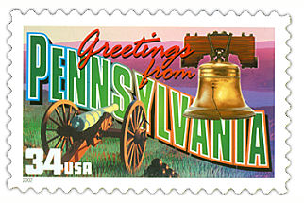
Case Study
Building Capacity for Better Work and Better Care: Pennsylvania Community Hospitals and Medical Centers
Cooperrider, David L., Diana Whitney, and Jacqueline M. Stavros. Appreciative Inquiry Handbook - For Leaders of Change. 2nd ed. Brunswick: Crown Custom, 2008. Print.

Slide 21

Question and Answer
Gina Lawson
RHP 8 Program Assistant
glawson@tamhsc.edu
512-341-4975
“Continue to seek ways to gain a deeper understanding of those things that give life to an organization and its people.”
Excerpt from Hunter Douglas Window Fashions Division AI result outcome.
Cooperrider, David L., Diana Whitney, and Jacqueline M. Stavros. Appreciative Inquiry Handbook - For Leaders of Change. 2nd ed. Brunswick: Crown Custom, 2008. Print.

